Slide 1



4: Strategic Analysis
Assess the Present Situation
Develop the Future Strategy
Cultural
Subsystem
3: Present Cultural Subsystem
5: Future Cultural Subsystem
Social
Subsystem
2: Present Social Subsystem
6: Future Social Subsystem
Change Brokering
Process Improvement
Technical
Subsystem
1: Present Technical Subsystem
7: Future Technical Subsystem

Slide 2
ABSENCING/HUBRIS
HOLDING ON
stuck in one self/will
MANIPULATING
DE-SENSING
SELF-DELUDING
ANTI-SPACE OF SOCIAL PATHOLOGY: Economics of destruction
stuck in one world/us (vs. them)
ENTRENCHING
ABUSING
NOT SEEING
stuck in one view truth/view
ABORTING
BLINDING
ANNIHILATING
DOWNLOADING
DESTROYING
PERFORMING
SUSPENSION
EMBODYING
SEEING
OPEN MIND
PROTOTYPING
U-SPACE OF SOCIAL EMERGENCE: Economics of creation
REDIRECTING
ENACTING
SENSING
OPEN HEART
CRYSTALISING
LETTING GO
OPEN WILL
LETTING COME
PRESENCING

Slide 3
 | Field structure of attention | Stream of Social Reality Creation
1. I-IN-ME |  | 1. Downloading talking Nice | speaking from what they want to hear Empty phrases, Polite, cautious AUTISTIC SYSTEM
2. I-IN-IT |  | 2. DEBATE talking tough | Speaking from what I think Exchange of divergent views I am my point of view ADAPTIVE SYSTEM
3. I-IN-YOU |  | 3. DIALOGUE reflective inquiry | SPEAKING FROM SEEING MYSELF AS PART OF THE WHOLE From defending to inquiry into viewpoints I can change my view SELF-REFLECTIVE SYSTEM
4.1 I-IN-NOW |  | 4. PRESENCING essential emergence | SPEAKING FROM WHAT IS MOVING THROUGH Co-creating something new Presence of an emerging future whole GENERATIVE SYSTEM

Slide 4
http://www.abs.gov.au/AUSSTATS/abs@.nsf/DetailsPage/8146.02016-17?OpenDocument

Slide 6
Instructions
HOW TO USE THIS TEMPLATE
Resave this Master Template as a new document with new name
All images are replaceable Right click on image > ‘Change Picture’
Using the Icons Library > Go to the last 3 pages of this document > Copy and paste where needed
To add pages > Right click > ‘New Slide’ OR > Right click > ‘Duplicate Slide’
5. To change the template of a slide > Click ‘Layout’ at top left corner > Select the template > Your slide should reflect the change
6. Charts To edit chart appearance > Select chart > Double click blue box
7. To edit chart data > Select inside chart > Double click grey box
8. To edit the colour of a segment in a chart > Select the segment (click twice on segment) > Go to ‘Paint Bucket’ in the menu (middle top)
9. Do not edit slides in the Master Pages
10. Remember to use colours from the Macquarie University colour palette only

Slide 7

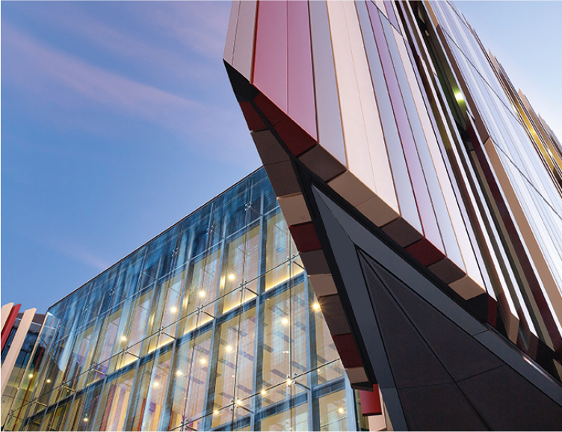
Cover title
SUBTITLE

Slide 8
SUBTITLE

Slide 9


Slide 10





Title
1.
A CULTURE OF TRANSFORMATIVE LEARNING IN A RESEARCH- /ENRICHED ENVIRONMENT
2.
IMPROVING THOSE ASPECTS OF OUR SUPPORT SERVICES TO REALISE THIS ASPIRATION AND VISION
3.
AN ACCELERATING AND IMPACTFUL PERFORMANCE IN DISCOVERY
4.
ALIGNING THE NATURE AND SIZE OF THE UNIVERSITY FOR THE FUTURE
5.
Creating an innovation nexus where Macquarie and our partners contribute solutions to the world and develop lasting relationships
7.
EMBOLDENING MACQUARIE UNIVERSITY’S RECOGNITION AND INTERNATIONAL PRESENCE
8.
DEVELOPING A VIBRANT AND SUSTAINABLE CAMPUS, CLEARLY AT THE CENTRE OF A RAPIDLY CHANGING NEIGHBOURHOOD IN THE INTERNATIONAL, COSMOPOLITAN CITY OF SYDNEY

Slide 11
Title three column layout
SUBHEAD
HEADER
Consectetur met adip isc ing elit aenean ac elit a felis pharetra we t adipis cing nam tinc idunt enim sit amet gravida nunc vel fringilla elit duis dui arcu amet.
HEADER
Consectetur met adip isc ing elit aenean ac elit a felis pharetra we t adipis cing nam tinc idunt enim sit amet gravida nunc vel fringilla elit duis dui arcu amet.
HEADER
Consectetur met adip isc ing elit aenean ac elit a felis pharetra we t adipis cing nam tinc idunt enim sit amet gravida nunc vel fringilla elit duis dui arcu amet.

Slide 12
One column layout
HEADER INFO
Consectetur met adipiscing elit. Aenean ac elit a felis pharetra met Adipiscing. Nam tincidunt enim sit Amet Gravida nunc vel Fringilla elit Duis dui arcu, amet scelerisque nec dictum ac conse eu elit Donec tincid unt enim sit amet consequat.
Lorum ipsum dolore melior nonne tutte san toro velum
Lorum ipsum dolore melior nonne tutte san toro
Lorum ipsum dolore melior nonne tutte san toro velum
Lorum ipsum dolore melior nonne tutte san toro

Slide 13
Two column layout
HEADER INFO
Consectetur met adipiscing elit enea n ac elit a felis pharetra met Adipisc ing. Nam tincidunt enim sit Amet ravida nunc vel Fringilla elit. Duis dui arcu, amet scelerisque nec dictu m ac conse eu elit. Donec tincidunt enim sit amet consequat eu elit lor em Consectetur met Met adipiscing. Nam tincidunt onsec tetur met adip iscing elit enean ac elit a aodr no velum.
HEADER INFO
Consectetur met adipiscing elit enea n ac elit a felis pharetra met Adipisc ing. Nam tincidunt enim sit Amet ravida nunc vel Fringilla elit. Duis dui arcu, amet scelerisque nec dictu m ac conse eu elit. Donec tincidunt enim sit amet consequat eu elit lor em Consectetur met Met adipiscing. Nam tincidunt onsec tetur met adip iscing elit enean ac elit a aodr no velum.

Slide 14




Title
Lorum ipsum dolroes melior nonne tutte san toro velum anon el se grande panto il a la grose delico dulce stugats. Ipsum dolroes melior nonne tutte san toro velum anon el se grande panto il a la grose delico dulce stugats
Heading
Heading
Heading
Heading
Lorum ipsum
30%
Lorum ipsum
30%
Lorum ipsum
30%
Lorum ipsum
30%

Slide 15







































Icon library
CHARCOAL – 43

Slide 16











































Icon library
CHARCOAL – 43

Slide 17













Icon library
CHARCOAL – 14

